Slide 1
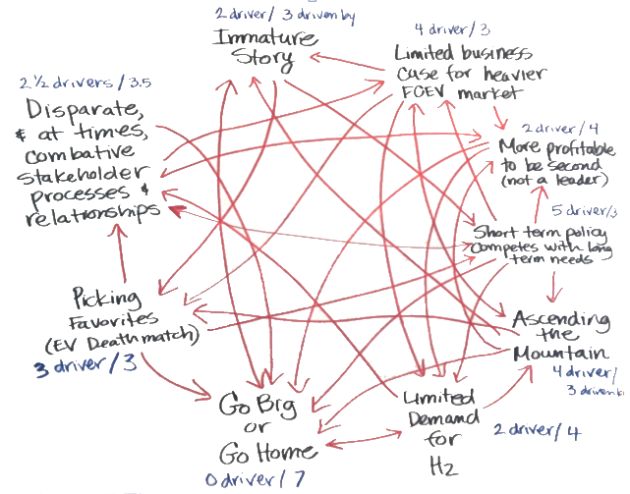
Interrelationship Diagraph

Slide 2
Why can’t I ever afford Christmas shopping?
Post issues in circle and move clockwise checking for relationships and drivers
No Job
1
Too many on list
6
Other expenses
2
Credit cards maxed out
Too Many bills
5
3
Not crafty
4

Slide 3
Why can’t I ever afford Christmas shopping?
Once the first issue is compared to the others, move to the second one
No Job
1
Too many on list
6
Other expenses
2
Credit cards maxed out
Too Many bills
5
3
Not crafty
4
No Job

Slide 4
Why can’t I ever afford Christmas shopping?
No Job
1
Too many on list
6
Other Expenses
2
Credit cards maxed out
Too Many Bills
5
3
Not crafty
4
Other Expenses

Slide 5
Why can’t I ever afford Christmas shopping?
No Job
1
Too many on list
6
Other expenses
2
Credit cards maxed out
Too many bills
5
3
Not crafty
4
Too many bills

Slide 6
Why can’t I ever afford Christmas shopping?
No Job
1
Too many on list
6
Other expenses
2
Credit cards maxed out
Too Many bills
5
3
Not crafty
4
Not Crafty

Slide 7
Why can’t I ever afford Christmas shopping?
No Job
1
Too many on list
6
Other expenses
2
Credit cards maxed out
Too Many bills
5
3
Not crafty
4
Credit Cards Maxed Out

Slide 8
Why can’t I ever afford Christmas shopping?
No Job
1
Too many on list
6
Other expenses
2
Credit cards maxed out
Too Many bills
5
3
Not crafty
4
Too Many on List

Slide 9
Why can’t I ever afford Christmas shopping?
Count up number of related issues that are drivers and those that are not drivers and post
No Job
4 / 0
1
Too many on list
3 / 1
6
Other expenses
1 / 4
2
Credit cards maxed out
1 / 3
Too Many bills
0 / 4
5
3
Not crafty
4 / 1
4

Slide 10
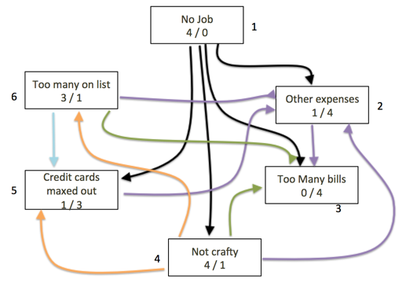
Why can’t I ever afford Christmas shopping?
Factor | # of Items this factor drives | Factor influenced by # others
No Job | 4 | 0
Other expenses | 1 | 4
Too many bills | 0 | 4
Not crafty | 4 | 1
Credit cards maxed out | 1 | 3
Too many on list | 3 | 1
Focus on Drivers for greatest impact

